Slide 1
CSE 331
Automata and computability
Building DFA
Spring 2026

Slide 2

Building DFA
Typical questions
Define a DFA which recognizes the given language L.
or
Prove that the (given) language L is regular.

Slide 3
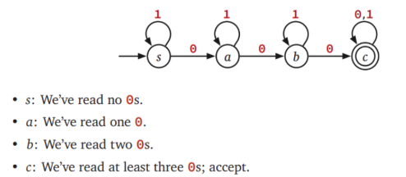
Building DFA
Example
Define a DFA which recognizes
L₁ = {w | all strings containing at least three 0s.}

Slide 4
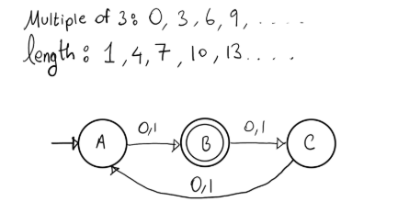
Building DFA
Example
Define a DFA which recognizes
L₂ = {w | the length of w is one more than a multiple of 3}

Slide 5
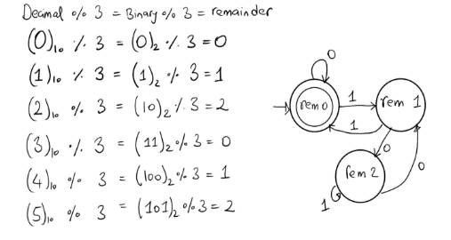
Building DFA
Example
Define a DFA which recognizes
L₃ = {w | w when interpreted as a binary number, is divisible by 3}

Slide 6
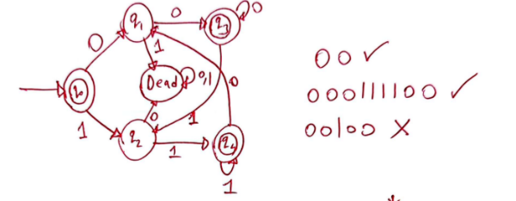
Building DFA
Example
Define a DFA which recognizes
L₄ = {w | all characters are repeated at least once wherever they appear in the string}

Slide 7
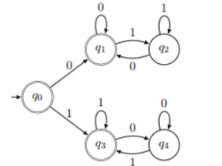
Building DFA
Example
Define a DFA which recognizes
L₅ = {w | w contains an equal number of occurrences of the substrings 01 and 10 }

Slide 8
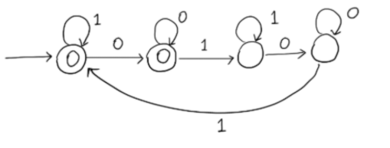
Building DFA
Example
Define a DFA which recognizes
L₆ = {w | 01 appears even number of times in w as a substring}

Slide 9
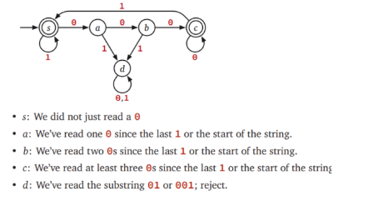
Building DFA
Example
Define a DFA which recognizes
L₇ = {w | all strings in which every run of 0s has length at least 3}

Slide 10

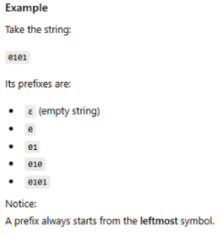
Building DFA
Example
Define a DFA which recognizes
L₈ = {w | all strings w such that in every prefix of w, the number of 0s and 1s differ by at most 1}

Slide 11
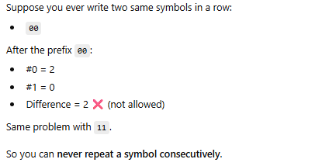
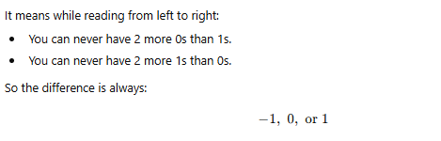
Building DFA
Example
Define a DFA which recognizes
L₈ = {w | all strings w such that in every prefix of w, the number of 0s and 1s differ by at most 1}

Slide 12
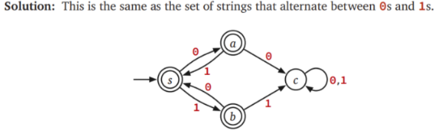
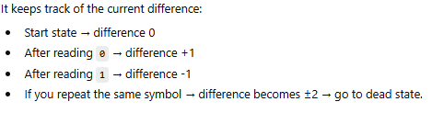
Building DFA
Example
Define a DFA which recognizes
L₈ = {w | all strings w such that in every prefix of w, the number of 0s and 1s differ by at most 1}

Slide 13
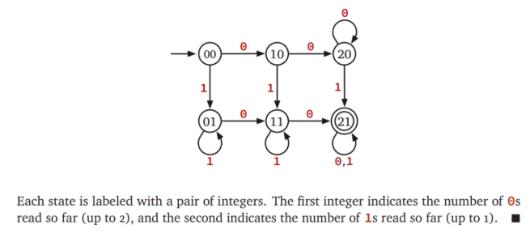
Building DFA
Example
Define a DFA which recognizes
L₉ = {w | all strings containing at least two 0s and at least one 1.}

Slide 15
Building DFA
Remember
States are our only (computer) memory.
Design and pick states with specific roles / tasks in mind.
"Have not seen any of desired pattern yet"
"Trap state"

